Slide 1


World Development Indicators
Predicting the state of World Trade in the next decade

Slide 2
Abstract - World Development Indicators
“ Trade is central to ending global poverty. Countries that are open to international trade tend to grow faster, innovate, improve productivity and provide higher income and more opportunities to their people. Open trade not only aids the development of Nations, States, and Countries but also fuels the development of the world. “ - World Bank Trade is an essential part of the Global Economy as well as the Economy of any participating nation. Trade accelerates the growth of a nation’s economy and empowers it to hold a formidable position in the world economy. Through this project, we are trying to inspect and analyse the various indicators of World Trade, and predict the status of World Trade in the year 2030.

Slide 3
What are the features of the dataset?
264
12
146
Countries
Timeline
Trade Indicators
The Dataset contains data of 264 countries across 12 years
The dataset has 12 years of data for all 264 countries - 1990, 2000, 2010 - 2019
The dataset has 146 trade indicators across 12 years for all 264 countries

Slide 4
What’s the process?
Redefined nomenclature, eliminated nulls, and removed duplicates
Shortlisted 12 countries and 12 indicators based on indicators
Tested storing the data in pandas dataframes & nested dictionary - chose latter
Predicted the World Trade indicators in 2030 using Linear Regression
Used joypy and matplotlib packages to develop graphs and observe trends
Data Cleaning
Feature Engineering
Data Manipulation
Model Development
Visual Analytics
We used Python to dig into the data obtained the World Bank’s Data Repository. The process included Data Cleaning & Manipulation, Feature Extraction, Model Development, and Visualization.

Slide 5
Data Cleaning
Defining Nomenclature
Drop Null Values
Eliminate Duplicates
Redefined nomenclature for various trade indicators
Used isna & dropna functions to detect null values and eliminate them
Used drop_duplicates function to eliminate duplicate values
Notes:
Rajas - I am only left with adding two cliparts on this slide

Slide 6
Feature Engg - Shortlisted Countries
PT
UK
ES
SWE
GER
USA
JPN
CHN
IND
BRZ
AUS
NZ

Slide 7
Feature Engg - Trade Indicators
Trade (%of GDP)
Merch Trade (% of GDP)
Import Value Index (2000 = 100)
Import volume index (2000 = 100)
Imports of Goods and Services (% of GDP)
Exports of Goods & Services (% of GDP)

Slide 8
Feature Engg - Trade Indicators
Food imports (% of merch imports)
Food Exports (% of Merch Exports)
Fuel exports (% of merch exports)
Fuel imports (% of merch imports)
Export Value Index (2000 = 100)
Export Volume Index (2000 = 100)

Slide 9
Data Structuring
- After downloading the CSV file from World Data Bank, we used pandas to load the entire dataset
- Care was taken to remove duplicates and null values
- Total number of rows present in the the dataframe was 38548
- Columns were renamed to easier conventions
- Filtered the dataframe in two data structures for storing data for 12 trade indicators and 12 countries:
- dataframes for each services containing country wise data
- nested dictionary of trade services and countries.
Notes:
Omkar

Slide 10
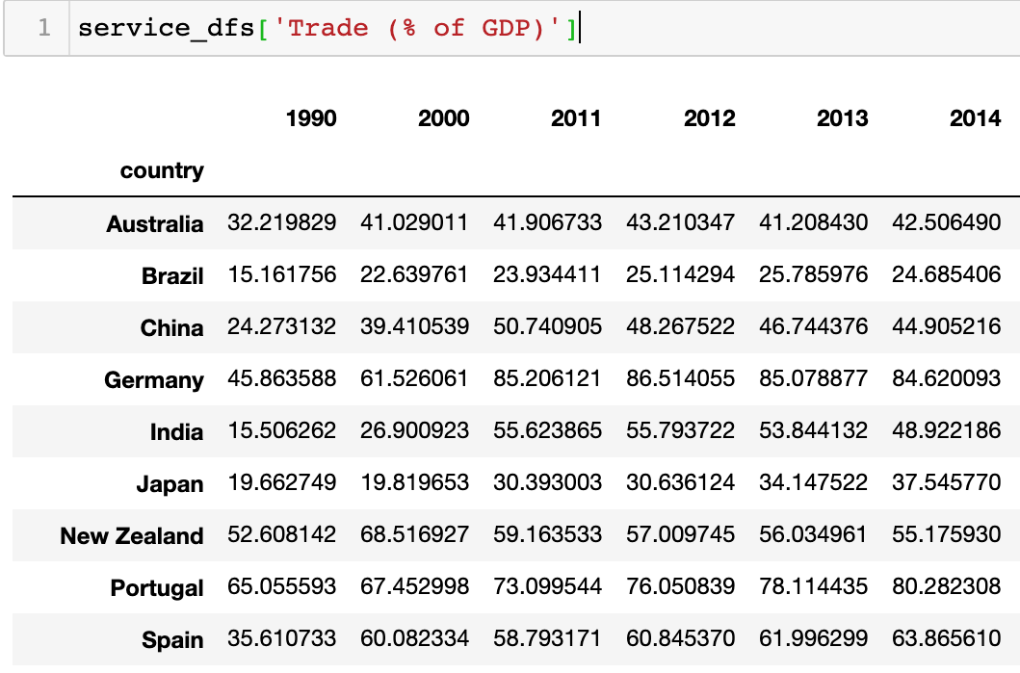
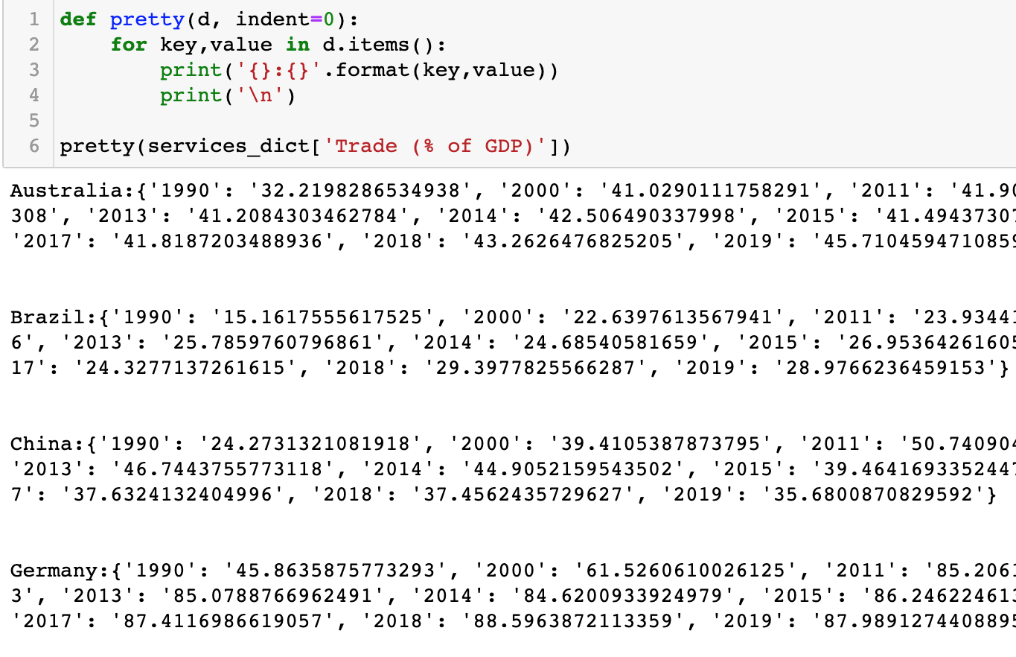
Data Manipulation: Data Structures in Use
Option 1: Pandas DataFrames
Option 2 : Nested Dictionary
Pandas is a powerful library used for manipulating large amounts of structured data called dataframes (eg: csv or excel files).
Nested dictionaries allow for faster lookups and theoretically have a look up time of O(1)

Slide 11
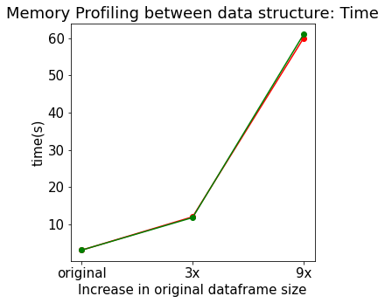
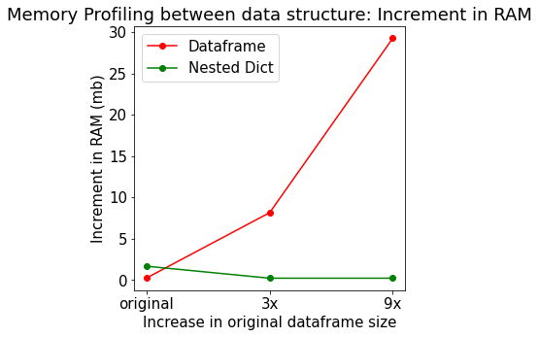
Comparing Data Structures by Memory Profiling
- Memory Profiler in python gives a line by line memory usage and time taken.
- The original dataframe was concatenated with it’s copies to reach 3x and 9x in size in order to check time and memory usage for larger data.

Slide 12
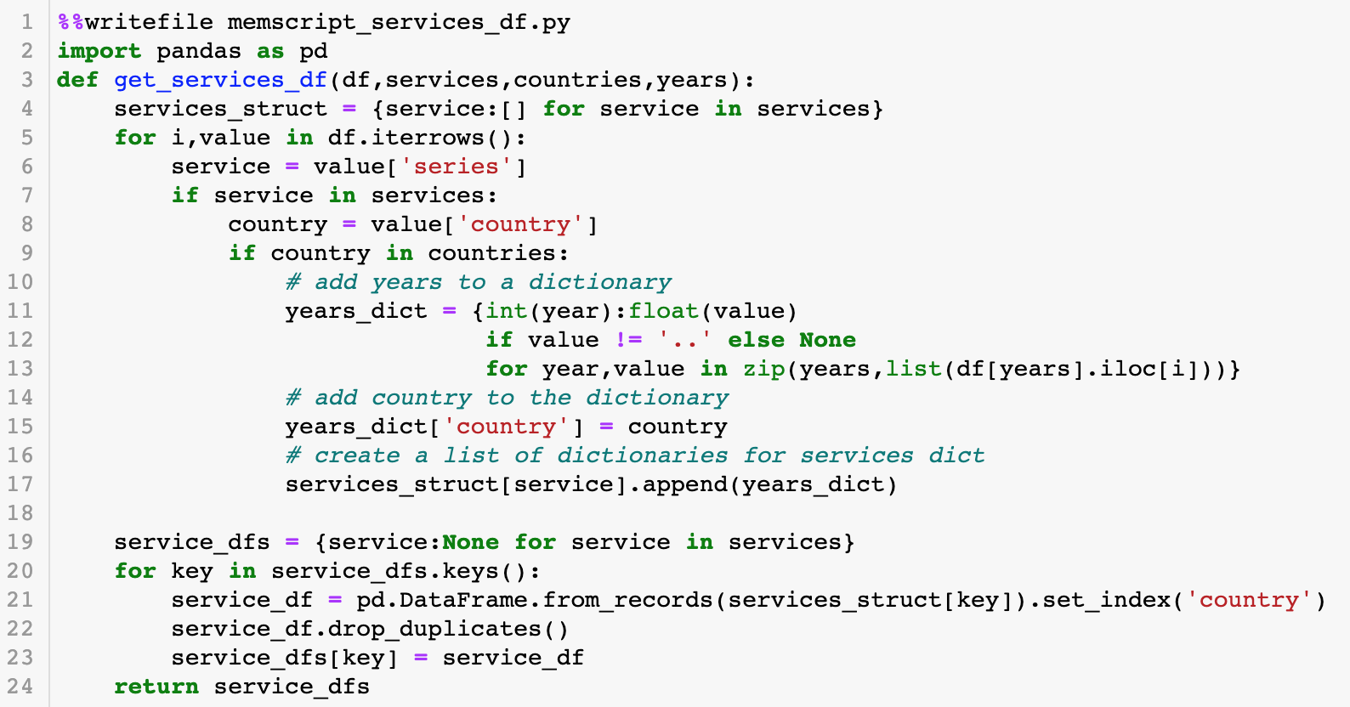
Data Manipulation: Dataframes - Pros and Cons
Pandas Dataframes
Pandas are great for huge datasets and help in doing better analysis. But Dataframes get heavier with more data.
Time
Time taken was highly correlated with the time to make a nested dictionary
Memory
Memory increments in RAM increased with increase in size of the dataframe
Lines of Code
More lines of code required to get dataframes

Slide 13
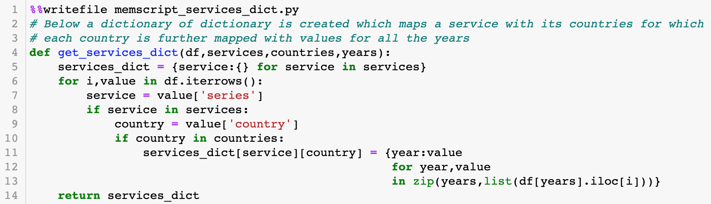
Data Manipulation: Nested Dictionary - Pros and Cons
Nested Dictionary
Nested dictionary is more pythonic. You don’t need to install any additional dependencies to implement them. They give a direct access to data for each service.
Time
Creating dictionaries took the same time as a Pandas dataframe and accessing it is O(1) theoretically
Memory
Uses less memory than a dataframe but can get difficult to work with for more nuanced datasets
Lines of Code
Less lines of code required to create a nested dictionary

Slide 14
Data Manipulation: Selecting Nested Dictionary
- Using Nested Dictionary would help in faster access to trade indicators and country data
- All the analysis done henceforth will be based off the nested dictionary
- Main goal was to use the knowledge taught in this course

Slide 15
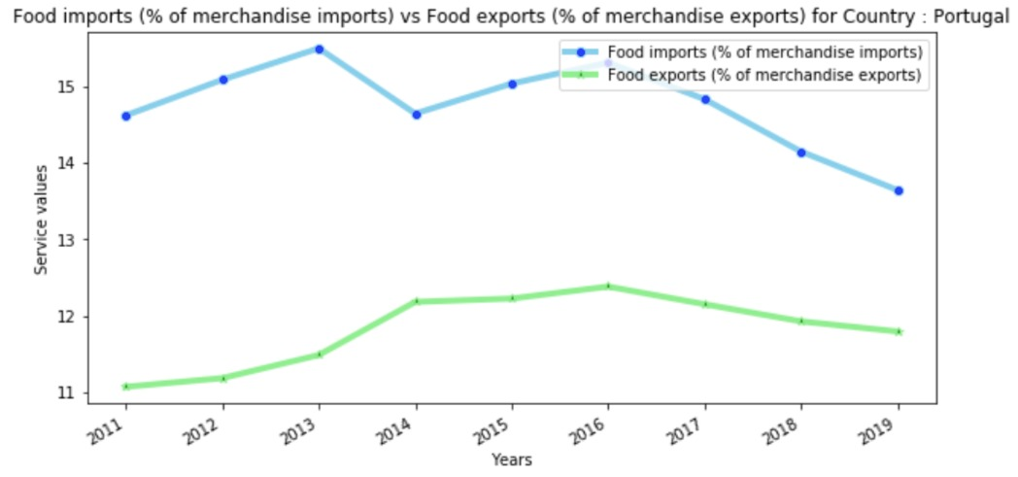
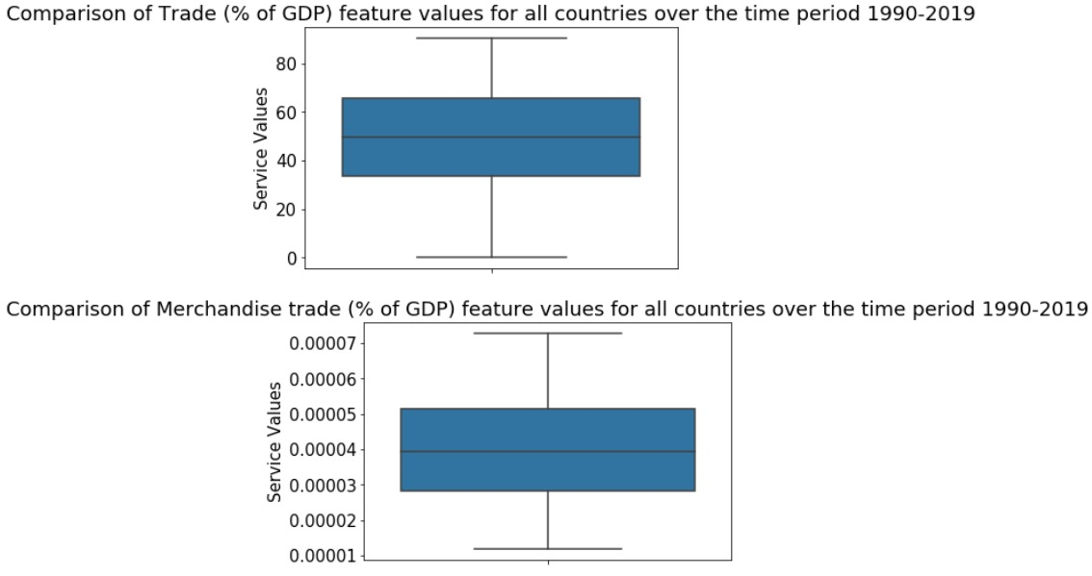
Insights from the graphs
Comparison of food imports and exports country-wise from 2011 to 2019
(Line graph)
Boxplot for the service values for all countries from 2011 to 2019

Slide 16
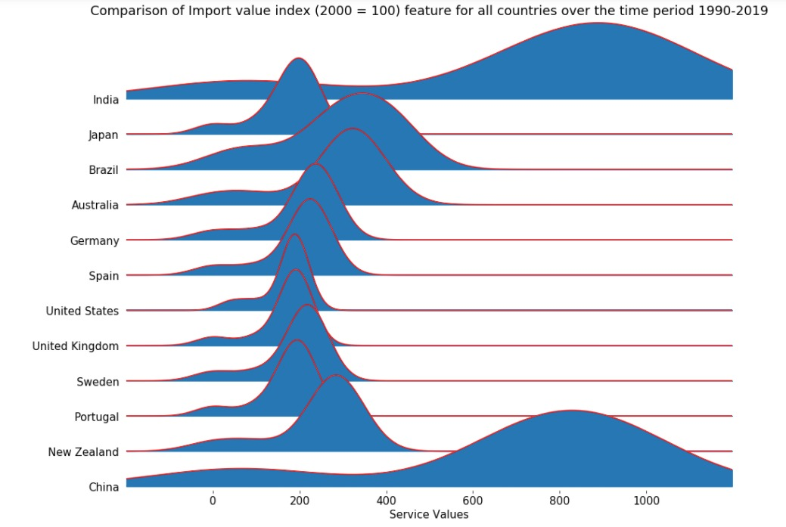
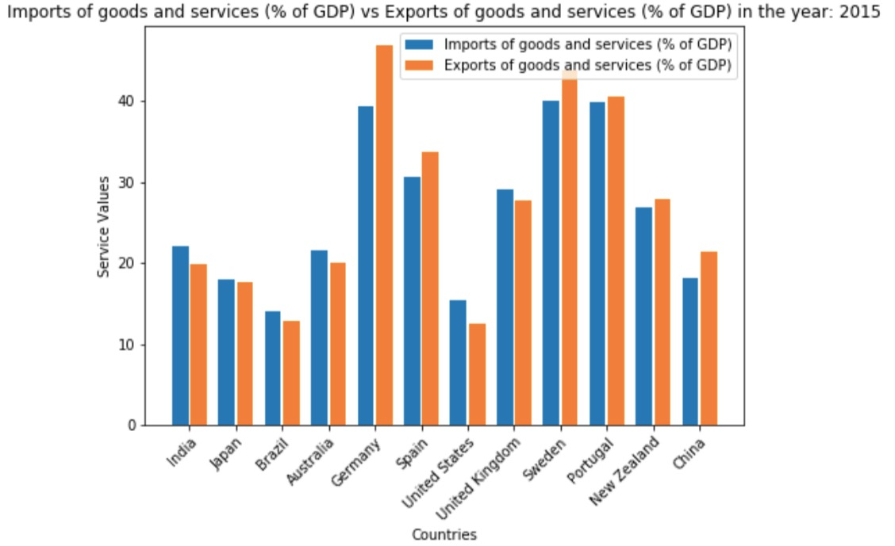
Insights from the graphs
Import value index values range for each country. Example, India and China have higher index values for most of the data points. (joyplot)
Year wise bar graph plot of countries for imports of goods values
Notes:
Add definition of index values. Give a very brief description.

Slide 17
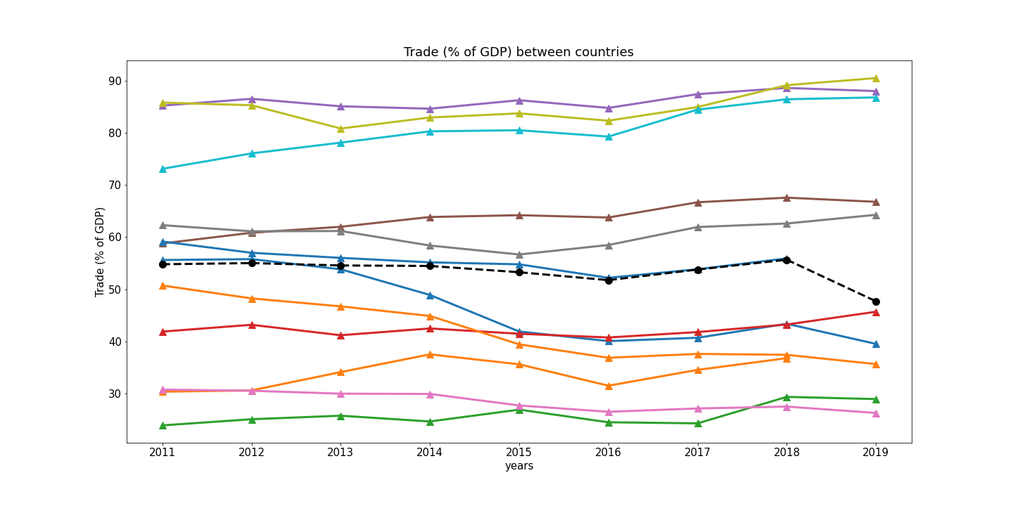
Insights from the graphs
Comparison of all countries for % of GDP service from 2011 to 2019
Notes:
Nikita

Slide 18
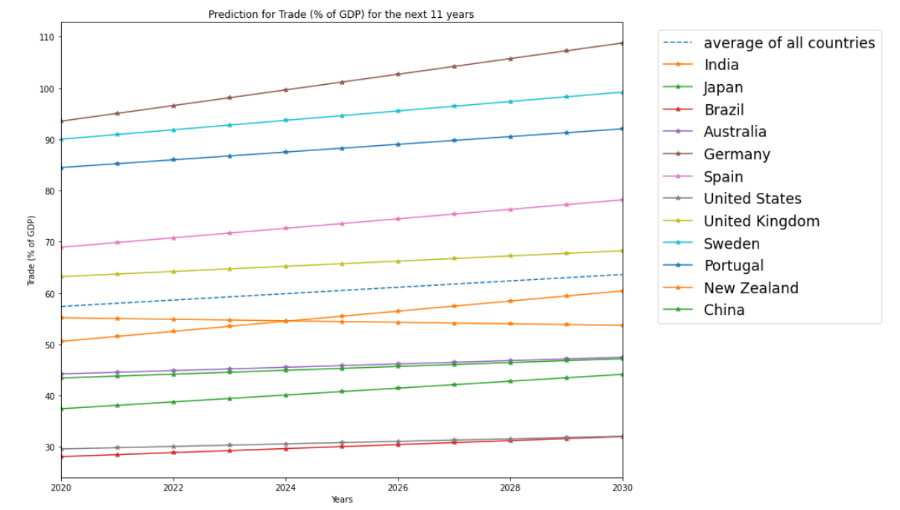
Predicting World Trade in 2030 - Linear Regression
Notes:
Nikita

Slide 19
Summary
Shortlisting down from 246 to 12 countries which had a dominant position in World Trade in the last decade (2010-2019)
Shortlisted from 146 indicators to 12 indicators - focusing on i. Trade ii. Import Value & Volume iii. Export Value & Volume iv. Food & Fuel Imports & Exports v. Goods & Services Imports & Exports
Stored the data in Nested Dictionary, with the following benefits - i. Time: Faster access to service and country data ii. Less memory and less lines of code being used iii. Application of knowledge taught in this course
Plotted a Linear Regression Model (using SciKit learn) to predict the state of International Trade in 2030 - i. Germany will gain a dominant position in the World Trade market ii. USA, China, and India will grow and maintain their positions in the World Trade Market
Notes:
Mention the Data Structure we preferred What the state of World Trade in 2030 would look like

Slide 20
THANKS

